Slide 1
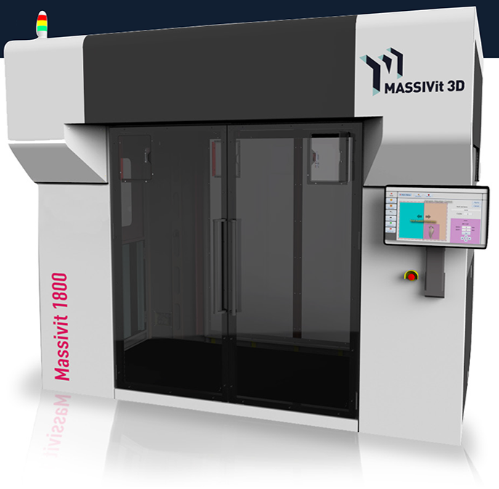
Massivit 3D
3D printing

Slide 2
Regular slide of text
Text
Subject 1
Subject 2

Slide 3
Section start

Slide 4
Regular slide of text
Text
Subject 1
Subject 2

Slide 5
4 subjects summary
❶ Subject one
❸ Subject three
Operates by focusing ultraviolet (UV) light on to a vat of liquid or powdered photo-polymer resin, hardening the selective areas only
Operates by heating materials, placing them in place and letting the 3D object cool and harden.
❷ Subject two
❹ Subject four
Operates by liquid binding agent that is selectively deposited to join powder particles layer by layer
Operates by ejecting photopolymer or other materials from printing heads to form a 3D object after curing

Slide 6
Font, Colors and Separators
Font: Calibri (body)
Colors
Arrows
Separators
1
2
3
4
5

Slide 7
Thank You!

Slide 8
Print head
Dispenser
UV LED
Tray

